Slide 1
Deep neural networks
Stock price prediction
Deep neural networks
Supervisor
Dr. Haris Papageorgiou
Athanasia Kolovou
Members
Karabasis Ilias
Polydoros Athanasios
Rempoulaki Anastasia

Slide 2

Contents
Introduction
Task definition
Dataset
Pre-processing

Slide 3
Introduction

Slide 4
Stocks 101
The closing price is the last price at which a security traded during the regular trading day
It’s used as reference when looking past prices of a stock
Stock price depends on several things
Enterprise
News
Tweets
Company decisions

Slide 5
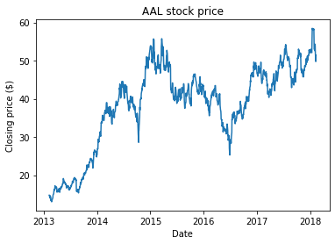
Example closing price of the stock

Slide 6
Task definition
Given the closing price of previous N days, predict the closing price of N+1 day.
The goal of the project is to train, test and compare 3 different models

Slide 7
Is this possible?
Most of papers/articles concludes that predicting stock price using just previous prices performs poorly on unseen data

Slide 8
Dataset

Slide 9
Dataset
Our dataset consists of S&P 500 stocks.
505 stocks during
Contains closing price between 2013-2018
Unused columns (Name, open price, close price, highest price, lowest price, date and volume)

Slide 10
Dataset facts
There are 619032 rows.
The closing price ranges from 1.59$ to 2049$
There are 505 stocks (some stocks renamed/added later/deleted)

Slide 11
Data Pre-processing

Slide 12
Preprocessing
Each row of dataset contain the closing price in dollar
Take a sliding window over the closing price of the window
Convert to the range [0, 1]

Slide 13
Price normalization
Apply Min max normalization over the test set.
Neural networks performs best with inputs within [0, 1]

Slide 14
Data slicing
Taking a sliding window over the normalized closing price.
Use the first values 20 values (0 - 19)
Slide the window by one and use this as input (1 - 20)

Slide 15
Models

Slide 16
Models
We will train and experiment with 3 models
Fit-forward neural network
RNN
RLSTM

Slide 17
Fit-forward neural network
Dense layers 2
A single output layer
64 units
RELU

Slide 18
LSTM
50 units
4 hidden layers
Output layer with 1 neuron
Adam optimizer
Mean Squared Error for loss

Slide 19
RLSTM
One part is the prediction module. Composed of a LSTM and a fully connected network layer.The input of this module is the prices of the stock we need to predict.
The other is the prevention module which is a fully connected network layer. Input of the second module is random data which are randomly extracted from the uniform distribution within the range between the highest and the lowest prices of the target stock.
Above the two modules, there is the third fully connected layer in the architecture. Its inputs are just the outputs of the two modules. The final result of the architecture can be obtained after computation of the third fully connected layer. Linear activation function is used in all three fully connected layers.

Slide 20
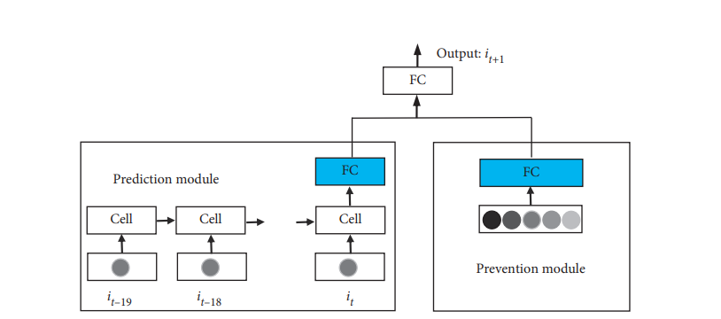
RLSTM

Slide 21
Experiments

Slide 22
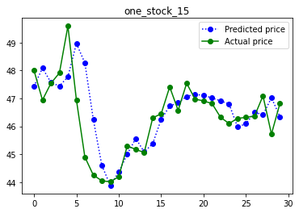
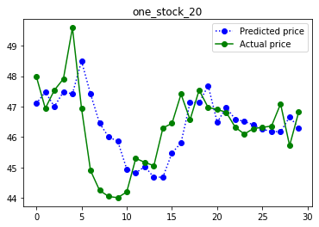
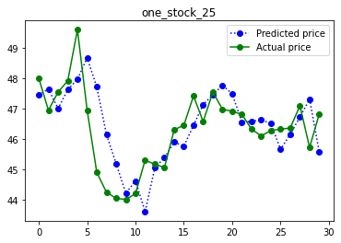
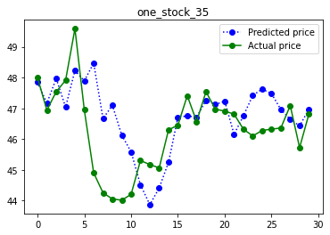
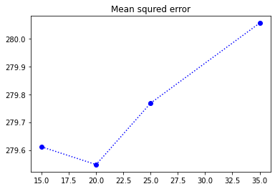
WIndow size
Train and test using different window size.

Slide 23
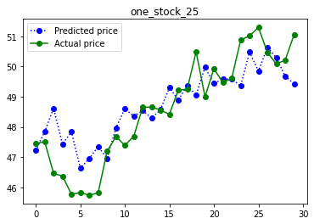
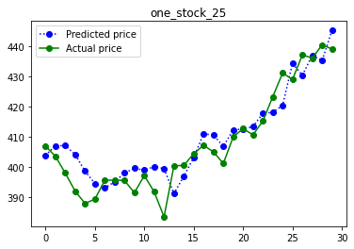
Fitforward NN
Trained/test same stock
Split dataset
MSE 282.4551
Test on unknown stock
Test dataset GOOGL stock
MSE 2327.6162

Slide 24
Error over different part of data
 | MSE | MAE | MAPE
Seen data | 563.79144 | 22.613684 | 97.4674
Unseen data | 2210.255 | 46.882046 | 98.04332
Other stock | 166421 | 407.6193 | 99.98

Slide 25
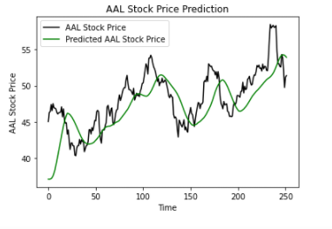
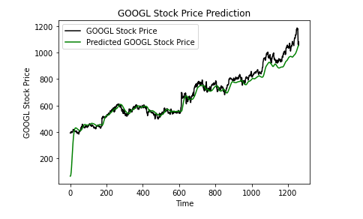
LSTM
Trained/test same stock
Split dataset
MSE 11.085469
MAE 2.6834064
MAPE 4.768626
Test on unknown stock
Test dataset GOOGL stock
MSE 418.25244
MAE 14.210677
MAPE 2.38179

Slide 26
RLSTM
Window size comparison
Window Size | MSE | MAPE | MAE
10 | 761.22406 | 2.7274594 | 18.96417
20 | 881.86264 | 3.047008 | 21.158346
30 | 686.7477 | 2.5506752 | 18.234316
50 | 846.5944 | 2.8268263 | 21.102041

Slide 27
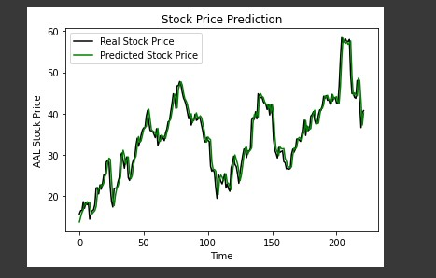
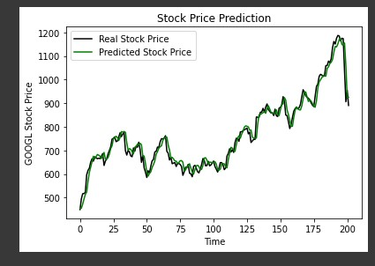
Seen data (AAL)
Unseen data (GOOGL)

Slide 28
Results

Slide 29
All three models managed to predict the general trends
All three models tend to slightly mispredict the exact value for the next day due to their difficulty to identify the change in the trend.
This is an indication that neural networks cannot accurately predict the price of a stock just by looking at its previous prices.
Worst model is the simple NN.
LSTM performed similar to RLSTM

Slide 30
Future work

Slide 31
The stock price prediction is a way more complex task than just predicting the next value of a time series. An interesting approach would be to provide more data about the market and include sentiment analysis on articles and tweets. Stocks are highly correlated with each other and belong go different sectors, this could be also provided as input to the model alongside some correlation between similar stocks.

Slide 32
Thanks!
ANY QUESTIONS?

